Slide 1

Student project

Slide 2
Project content :
How does the web works?
What do you need to be a web developer?
What’s the role of a web developer.

Slide 3
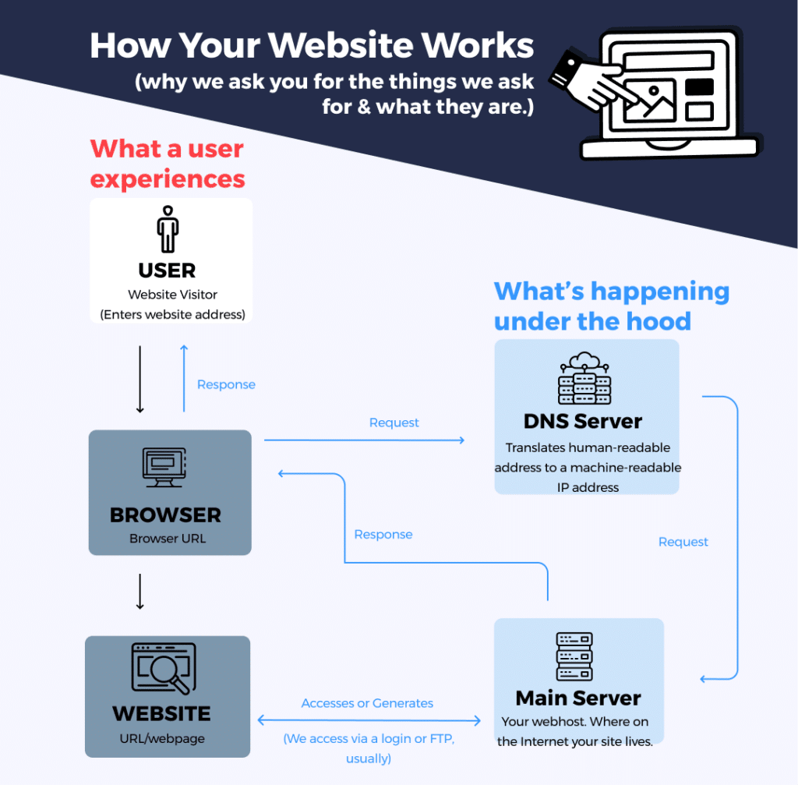
How does the web works?
How does the web works?

Slide 4
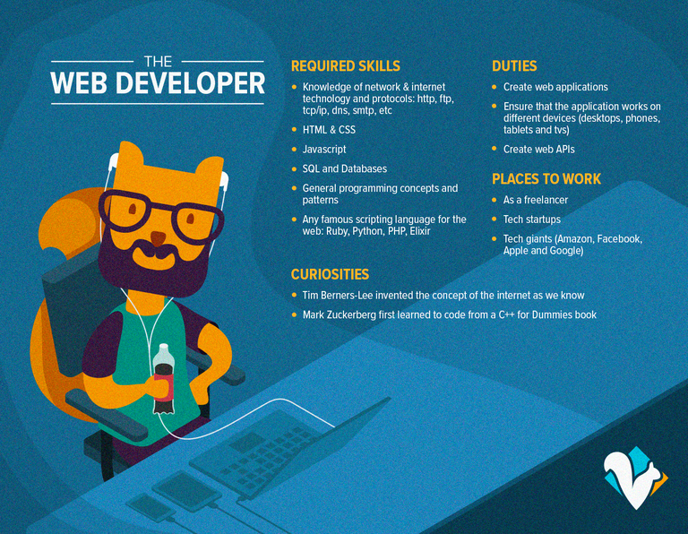

What do you need to be a web developer?

Slide 5
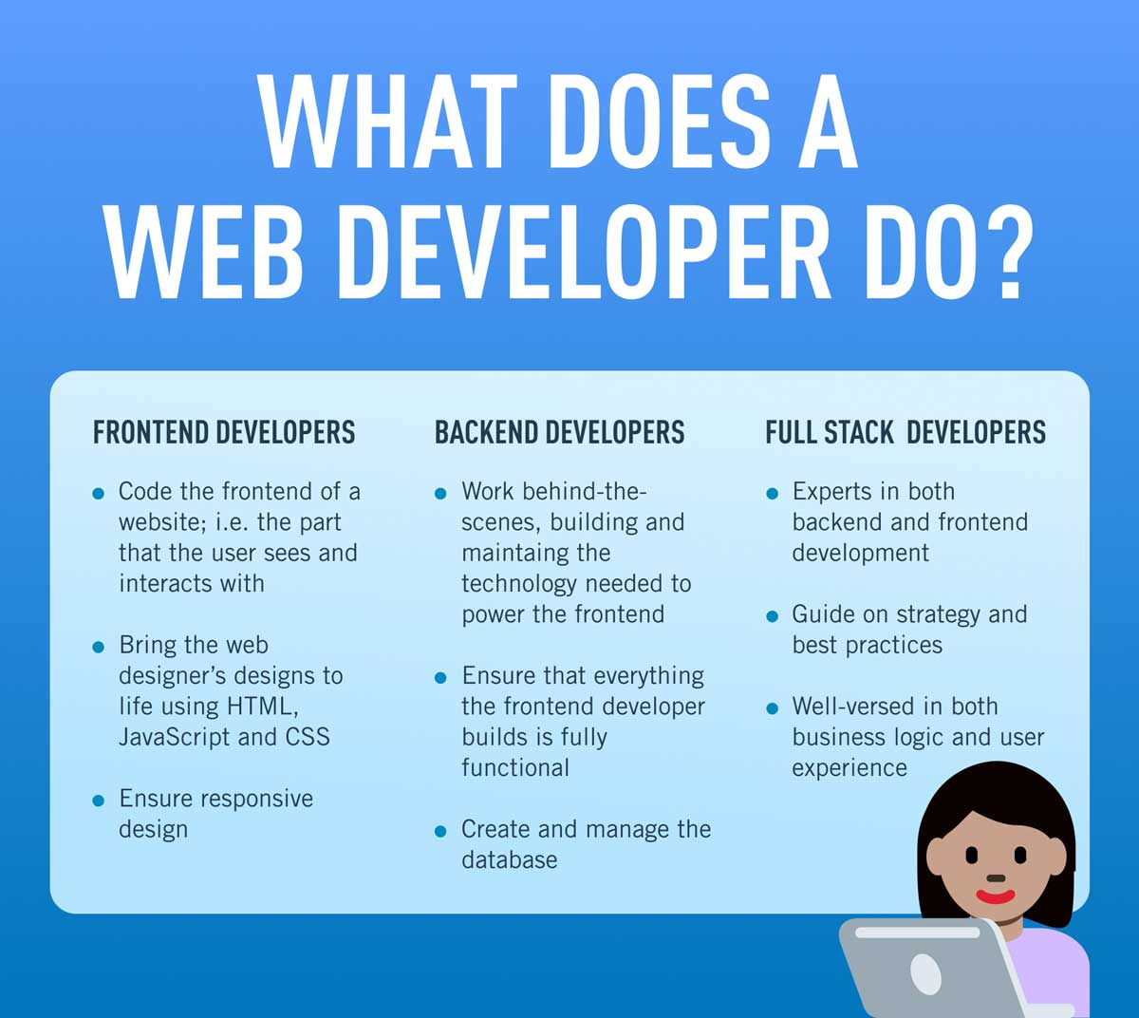

What’s the role of a web developer?

